Slide 1
Process-Based Evaluations
Student Name
Institution Affiliation

Slide 2

Introduction
Agenda
Description of process-based evaluation
Strengths of process-based evaluation
Weakness of process-based evaluation
Analysis of strengths and weakness
Notes:
The process-based evaluations is one of effective and efficient program evaluator used in most of the organization. The human service programs is evaluated using process-based evaluation and it has positively impacted its process-outcome relationship resulting to remarkable services. The process-based evaluations can be well reviewed through; description, identification and analyzing both strength and weakness.

Slide 3

Description of Process-Based Evaluations
Process-based evaluations (PBEs) instills advance
knowledge on the program functioning.
PBEs determines how adequately the program
implemented the strategy provided by the
logic model
PBEs focuses on three logic model segments; inputs,
activities and outputs
PBEs authorizes evaluators to distinguish between theory failure
and implementation failure.
Notes:
In human service program the process-based evaluation is utilized by evaluator to establish the program success in addressing the targeted activities. Notably, the process-based evaluations is based on the three segments of logic model that include; inputs, activities and outputs. When distinguishing between theory of failure and implementation failure, evaluators acknowledges the fact that implementation failure presents the poor implementation practices while theory of failure presents the failure in the presided expected outcomes (Sridharan, & Nakaima, 2011)

Slide 4
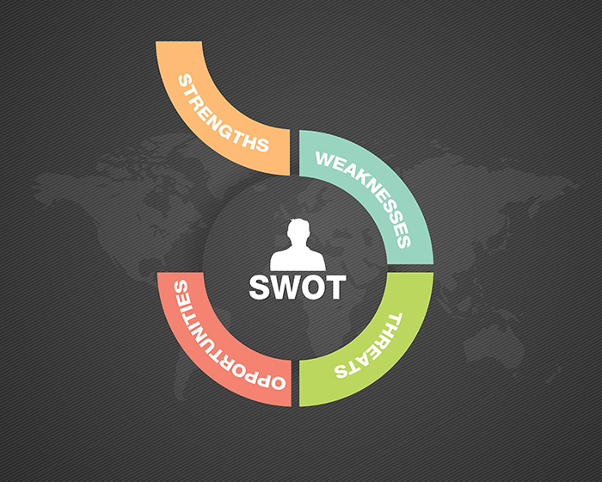
Strength of the Process-Based Evaluations
Integrity- PBEs provides quality improvement initiative
Reliability- provides a risk adjustment measures that defines target population
Validity - in PBEs process measurers are quickly collected as compared to the
outcome data
Notes:
The strengths of the process-based evolutions are based on integrity, reliability and validity . Through continuous process measurers the process-based evaluation has ensured quality of human services offered by designed program. Further, the numerous factors that are provide by this evaluation program has helped providers in risk adjustment for the targeted population making it more reliable (Sridharan, & Nakaima, 2011). Also validity is ensured since process measurers are timely collected.

Slide 5
Process- Based Evaluation Integrity
PBEs provides feedback for quality improvement
Process measurers identifies factors that affects clients/customers in human service program
PBEs provides actionable information in human service program
PBEs provide measurers that are feasible and attractive limiting additional data collection and burdensome
Notes:
Process-Based Evaluations are widely used in human service program and this has been triggered by its descriptive designation that build both customers and providers trust (Sridharan, & Nakaima, 2011). The PBEs; provides feedback for quality improvement, identifies influencing factors, provide actionable information, and also provide feasible and attractive measurers triggering program integrity.

Slide 6

Process-Based Evaluations Reliability
PBEs provides a risk adjustment measures that defines target population.
Process measurers defines population eligibility in human service program
PBEs defines and measures several customers characteristics that can be used in risk management.
Accurate application of PBEs prevent risks related to time and expenses.
Notes:
The process-based evaluation promotes human service program reliability by presenting risk adjustment measure that is based on the target population, defining population legibility, customers characteristics adjustment as well as preventing risk related to expenses and time mismanagement (Sridharan, & Nakaima, 2011)

Slide 7
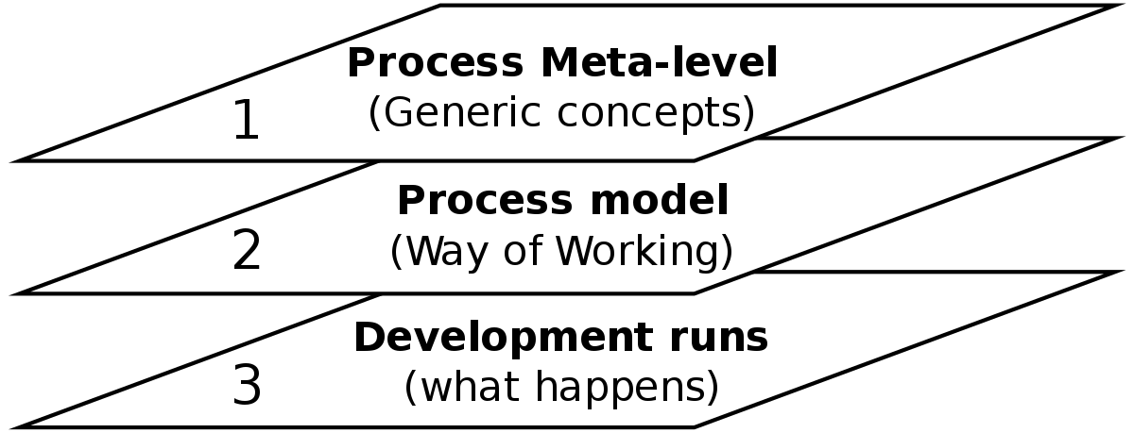
Process-Based Evaluations Validity
In PBEs process measurers are quickly collected as compared to the outcome data
Provide long time quality of care that can be reviewed in future
PBEs takes less time in accumulating , observing and processing customers' data
The use of PBEs routinely collected data integrates providers and customer relations validating it.
Notes:
Notably, most of PBEs process measurers that are linked with human service program are quickly collected from clients enabling the providers to determine quality long time reliable outcome data. The process has also been proven to take limited time in observing, accumulating and processing program data, this integrates process-outcomes relationship (Sridharan, & Nakaima, 2011)

Slide 8

Weakness of Process-Based Evaluation
It is hard to ensure validity from previous established evidences
Mostly PBEs links good care with inferior outcomes triggering paradoxical problem.
In the absence of evidence of linking process-outcomes establishing the link might be expensive and impossible process for the human service program.
The PBEs might be less useful to human service program since customers values outcomes more than measurers .
Notes:
Despite of many strengths of the process-based evaluations in human service programs, there are also some underlined disadvantages that hinders program services. The challenge is mostly brought by the establishing the previous links of the process-outcomes relationship since the data might be biased thus invalid for use. Also, it has been identified mostly in hospital program that most of providers link good care with inferior outcomes that might be drowned from previous data, this cases paradoxical problem limiting services (Reuter, Schweizer, & Van Herwijnen, 2015)

Slide 9

Analysis of PBEs Strengths and Weakness
PBEs Supplying data and program environment description has promoted human service program validity
PBEs design and implementation descriptions promotes reliability of human service programs rendering the comprehensive to customers.
PBEs are legitimate, cheap and formative but are at high risk of bias
Improper system evaluation results to wrong operation suppression
Notes:
When analyzing, both the strengths and weakness of process-based evaluation pros and cons are weighted to establish an actionable decision. PBEs strengths that’s are drown from validity , reliability and integrity has revealed that the approaches is quick, time and expense cautious and trusted by both providers and customers. Also PBEs ensures that programs are well designed and described to meet the environmental stated obligations. On the other hand, however PBEs promotes programs affordability and legitimacy, it also vital to note that they are at high risk of bias, and their improper evaluation might interfere with program operations (Ross, 2010)

Slide 10
Conclusion
The Process-Based Evaluation has been investigated based on human service program
The PBEs description reviewed that logic model focuses on three segments; inputs, activities and outputs
Evaluators have the obligation of reviewing both theory of failure and implementation failure in a program
PBEs presented validity, reliability and integrity strengths in program evaluation.
PBEs links good care with inferior outcomes triggering paradoxical problem

Slide 11
References
Reuter, B., Schweizer, J., & Van Herwijnen, A. (2015). A process- based approach to estimate point snow instability. The Cryosphere, 9(3), 837-847
Ross, M. E. (2010). Designing and using program evaluation as a tool for reform. Journal of Research on Leadership Education, 5(12.7), 481–500.
Sridharan, S., & Nakaima, A. (2011). Ten steps to making evaluation matter. Evaluation and Program Planning, 34(2), 135–146. .

